Slide 1
Humans and their brains
The human brain is truly unique
Human brain complexity can be seen only on the cellular level
The nature of the brain and its complexity helps it being unique
Humans approach problems and solving them using the complexity of the brain.
The ability, speed and quality to acquire and apply knowledge and skills is known as Intelligence.

Slide 2
Solving problems using a human brain
How do humans approach problems?
The brain creates algorithms to approach problems, however these algorithms aren’t implemented the same way as in computer logic design
Human brain is well adapted to processing analog (visual and audio) input
Human brain is extremely well adapted to pattern matching – even when the patter is not there
Human brain intelligence has a known and important aspect known as heuristics.
Heuristics enables a person to discover or learn something for themselves.

Slide 3
Solving problems using a computer
How do computers approach problem solving?
Going straight forward with pre-defined algorithms without using heuristics
Is heuristics applicable in intelligent computer programs?
Way different way of how brain works…
The complexity is much lower…
The ability is much lower…
The speed is much faster

Slide 4
Task I: Human vs Computer
Find five problems where humans outmatch computers in finding a solution
Find five problems where computers outmatch humans in finding a solution

Slide 5
FAQ
Reasons to learn a new language:
- changes the way you think
so you can read code
so you can access a new platform

Slide 6
Task II
How did you get to SEDC, today?
Do it as atomically as possible
Include every logical decision
Time to complete: 10-15 minutes

Slide 7
What is an algorithm?
The sequence of instructions used to solve a specified problem in a finite amount of time with finite amount of data.
Written (or verbal) description of logical sequence of actions, applied to specific objects.
What is programming?
The process of writing a sequence of instructions (algorithms) to be executed by a computer

Slide 8
What does a programmer do?
The programmer begins the programming process by analyzing the problem,
breaking it into manageable parts, and developing a general solution for each piece called algorithm.
Usually, at minimal, computer problems could be only one set of logical
instructions (one algorithm), but sometimes programmers need to write and
combine multiple sets of logical instructions (algorithms) to solve certain problem.
Complex software programs could be consisted of thousands or millions of
algorithms that all together solve a lot of problems through automation and therefore creating intelligence.
At the end of this academy program, you’ll be able to write complex software applications with abnormal complexity.

Slide 9
And how do we do that?
Same as in real-world, to express our human brain reasoning, operations and solving problems, we need to use our input and output senses to perform these operations. In order to express our reasoning, we need to use verbal or non-verbal communication mechanisms.
Programming languages could be perceived similarly to natural languages, they have syntax, they have structure, rules, symbols and special words in order to communicate the human brain set of instructions (algorithm) to the computer.

Slide 10
And how do we do that?
Programming language is a formal language designed to communicate instructions to a machines, particularly a computer.
Programming languages are used to create programs which express algorithms in the machine and control the behavior of the machines.
Programming languages are the way how we ‘talk’ to Computers – and sometimes to each other

Slide 11
What are programming languages made of?
Syntax of a programming language is mainly textual, where each
programming language has it’s own reserved keywords and basic rules of how to combine them and create concrete atomic instructions in order to translate algorithm into programming code which is then converted into machine code(101000101010) which is understood by the machine.
Semantic is the meaning of the language

Slide 12
Programming Languages Categories
Fundamentally, there two programming language categories:
Low-level
High-level
Low-level are machine-dependent, which means every machine has it’s own unique machine language.
High-level are machine independent, and can be executed on various computers.

Slide 13
Low-level languages
Machine languages are the natural languages of the computers…
Instructions are set of 1s and 0s
If we would write programs in machine language, it would look like this: 10010101 11100101
10001011 11110010 10111001
10100010 11001001 11101010
10000010 01110101
One level above the machine language is the assembly language.

Slide 14
Low-level languages
Assembly language allows programmers to write machine code using symbolic programming.
Example:
MOV 0, SUM MOV NUM, AC ADD SUM, AC STO SUM, TOT
Writing programs in assembly would make more sense than writing program directly in machine using 1 and 0.

Slide 15
High level languages
Using low-level languages, computer programmers would need to write a lot of instructions in order to perform even simplest
operations.
High-level languages were developed to speed-up the process of developing computer programs.
High-level languages allow programmers to write programs which are very similar to the natural English language.
The code computer programmers write in high -level languages is known as source
code.

Slide 16
High level languages
In order source code to be translated successfully into machine code (because machines only understand machine code), we need process of compilation.
The process of translation helps creating from source code to end-result object, which is the
executable output used to represent the program developed by the programmer.
There are two types of translators:
Compiler - a translation program that convert the programmer’s entire high-level program, which is called the source code, into a machine language code, which is called the object code. This translation process is called COMPILATION.
Interpreter – a translation program that converts each program statement (line by line) into machine code on the fly, just before the program statement is to be executed. Translation and execution occur immediately, one after another, one statement at a time.

Slide 17
Research
Find 10 high-level programming languages
Put them in ordered list by highest usage worldwide…
Discuss their features and their appeal with the class
Make a feature comparison chart for all of them

Slide 18
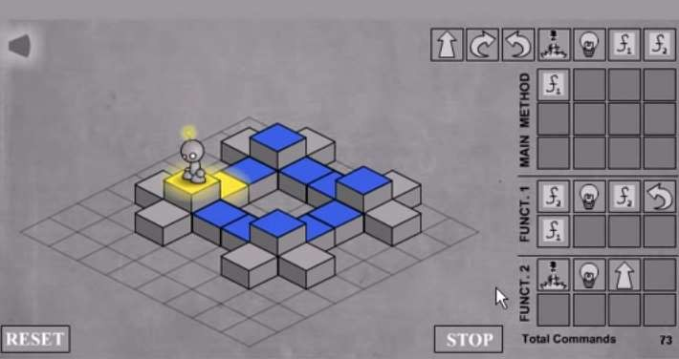
Homework
Finish LightBot (and provide a screenshot)

